Slide 1
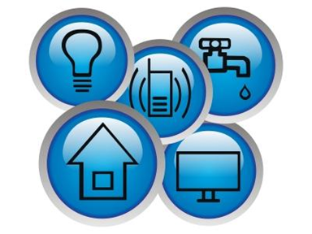
Utility
Tracker
Miles Crabbe, Ethan Downey, Chad Easter

Slide 2
Problem Definition
There is no unified utility outage/performance tracker
None are app based
All are in house programs and based on classical styles of gathering data, sensors, tests, etc.

Slide 3
Purpose of Our App
Provide easy to read analytics for both consumers and companies
Provided consumers and companies with up to the minute knowledge regarding the current state of their services
Allow consumers to be more informed

Slide 4
Demo

Slide 5
What Changed
We were unable to implement a server due to lack of hardware and Android coding experience (but we did make it easy to convert)
Original Design relied too heavily in cross activity communication with dynamic data, in other words we ended up refreshing data arrays more often than actually using the data.
Leaderboards were not feasible with initial data structure we implemented and a overhaul would not have been worth the time
Specific usernames was not necessary after we implemented it, everywhere we tried to place it, it looked cumbersome and forced
User accounts are now randomly assigned in a way similar to Yik-Yak

Slide 6
What we learned/used
Google Maps API & Reverse geolocation
SQLite database implementation
Singleton Design pattern makes refreshing data easier
Callbacks and multithreading in order to speed up geocoding

